Slide 1
Single-Cell RNA Sequencing: Decoding Cellular Complexity
Salwa Elsaadawy

Slide 2
Introduction
Single-cell RNA sequencing has increased our ability to study gene expression at the single-cell level.
It also enables the analysis of cellular heterogeneity and provides insights into complex biological systems.
In this presentation, we will explore the fundamentals of Single-cell RNA sequencing data analysis using Seurat.

Slide 3
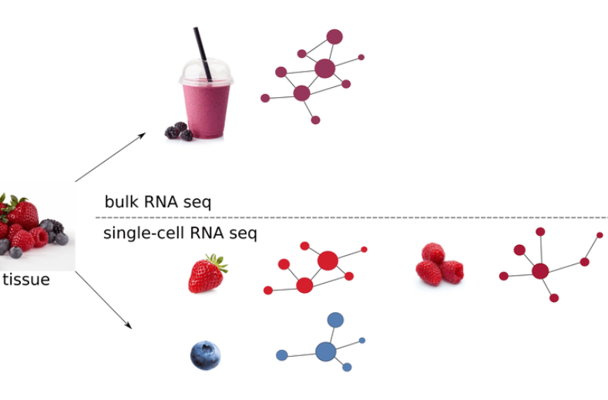
What is Single-cell RNA sequencing?

Slide 4
Workflow of Single-cell RNA seq
Sample preparation
Cell lysis
Reverse transcription
Library preparation
Sequencing
Data analysis
Notes:
Sample preparation: In this step, individual cells are isolated and captured from the biological sample of interest. Various techniques are employed for this purpose, including microfluidics, microwells, or droplet-based methods. These methods ensure that each cell is captured individually, allowing for the analysis of gene expression at a single-cell level.
Cell lysis: Once the cells are isolated and captured, they need to be lysed to release the RNA molecules. Cell lysis involves breaking down the cell membrane and organelles to access the RNA content. This step ensures the release of the cellular RNA into the surrounding solution.
Reverse transcription: After the cells are lysed, the RNA molecules are subjected to reverse transcription. Reverse transcription is a process where RNA molecules are converted into complementary DNA (cDNA). This conversion is achieved using reverse transcriptase enzymes, which synthesize a complementary DNA strand based on the RNA template.
Library preparation: Once the RNA molecules are reverse transcribed into cDNA, the cDNA needs to be prepared into a sequencing library. This step involves several processes, such as fragmentation of cDNA, addition of sequencing adapters, and amplification of the library using polymerase chain reaction (PCR). The library preparation step ensures that the cDNA is ready for high-throughput sequencing.
Sequencing: The prepared library is then subjected to high-throughput sequencing technologies, such as next-generation sequencing (NGS). NGS allows for the rapid and parallel sequencing of millions of DNA fragments or cDNA molecules within the library. During sequencing, the sequencing instrument records the sequence of each cDNA fragment, generating vast amounts of data.
Data analysis: After sequencing, the resulting data needs to be processed, analyzed, and interpreted. This step involves bioinformatics tools and algorithms that handle the large volumes of sequencing data. Data analysis encompasses steps such as read alignment, quality control, normalization, identification of differentially expressed genes, clustering of cells into subpopulations, and visualization of the results. The goal is to extract meaningful biological insights from the scRNA-seq data, such as identifying cell types, characterizing gene expression patterns, and understanding cellular heterogeneity.
Overall, the scRNA-seq workflow combines molecular biology techniques, high-throughput sequencing, and computational analysis to provide a detailed understanding of gene expression at the single-cell level. It enables the exploration of cellular heterogeneity, cellular dynamics, and the identification of rare cell populations within complex tissues.

Slide 5
Applications of scRNA-seq
Uncovering cellular heterogeneity
Cell development and differentiation
Disease research

Slide 6
Tutorial for Single-cell RNA Sequencing Data Analysis with Seurat
Dataset description:
We will be working with a dataset of Peripheral Blood Mononuclear Cells (PBMC) obtained from 10X Genomics.
The dataset consists of 2,700 single cells that were sequenced on the Illumina NextSeq 500 platform.
PBMCs are a mixed population of immune cells found in peripheral blood.

Slide 7
Setup the Seurat Object and Dataset Description
Seurat Object and Data Reading Seurat Object Structure
Data exporation
Data analysis
Data visualization

Slide 8
Quality Control (QC) and Data Exploration
QC Metrics for selections Pre-processing Workflow Overview 1.Selection and filtration 2.Data normalization and scaling 3.Detection of highly variable features

Slide 9
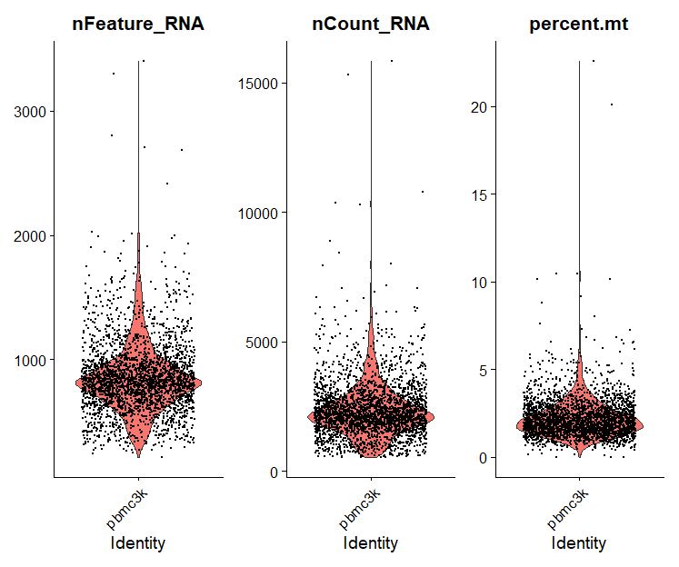
Violin Plot Shows Distribution Analysis of PBMC Features

Slide 10
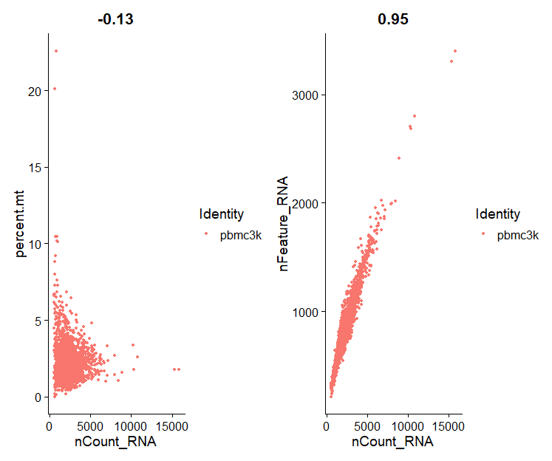
Exploring Feature Relationships: Insights from Feature Scatter Plots

Slide 11
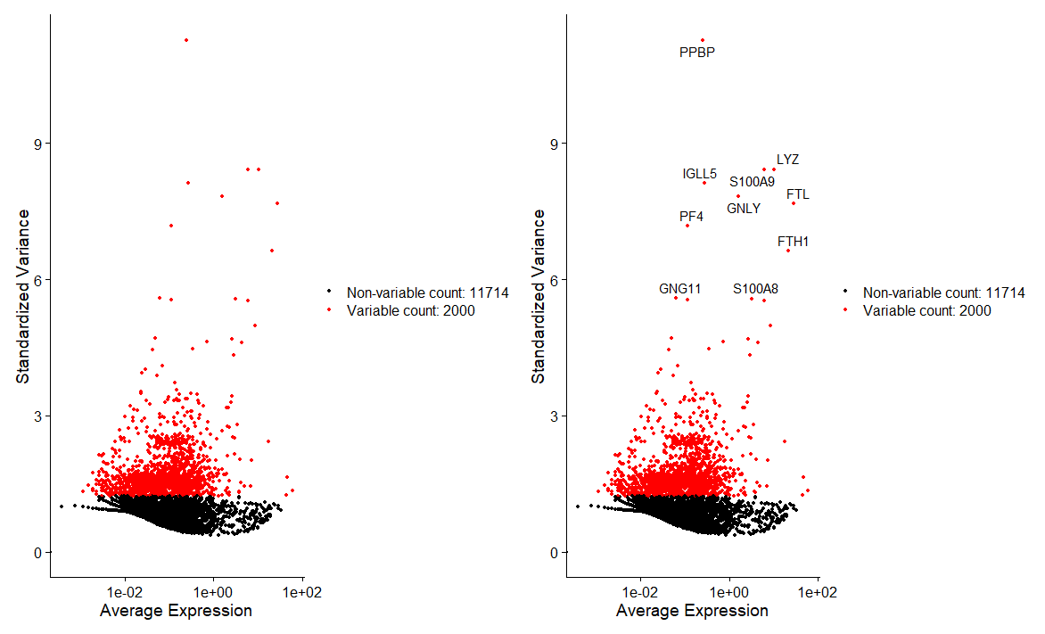
Normalization and Variable Feature Selection
Normalization
Variable feature selection

Slide 12
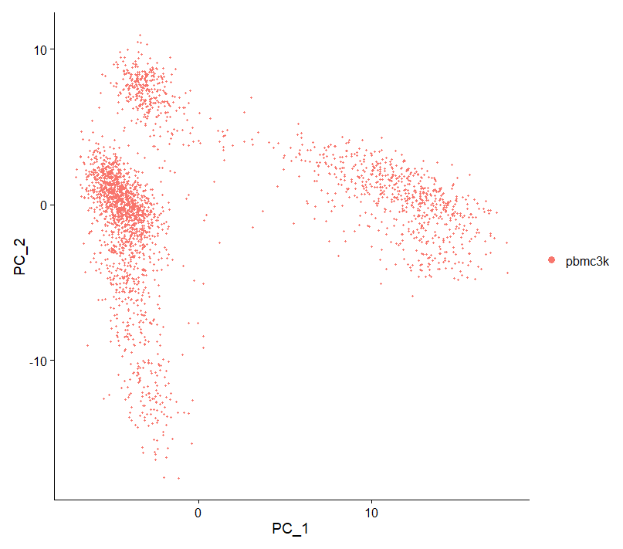
Principal Component Analysis (PCA) Results
PCA results capture gene expression variation, facilitating comparison, clustering, and visualization of single-cell transcriptomic data.

Slide 13
Clustering and Marker Analysis
Find Neighbors
Find Clusters
Cluster Identification
UMAP Visualization

Slide 14
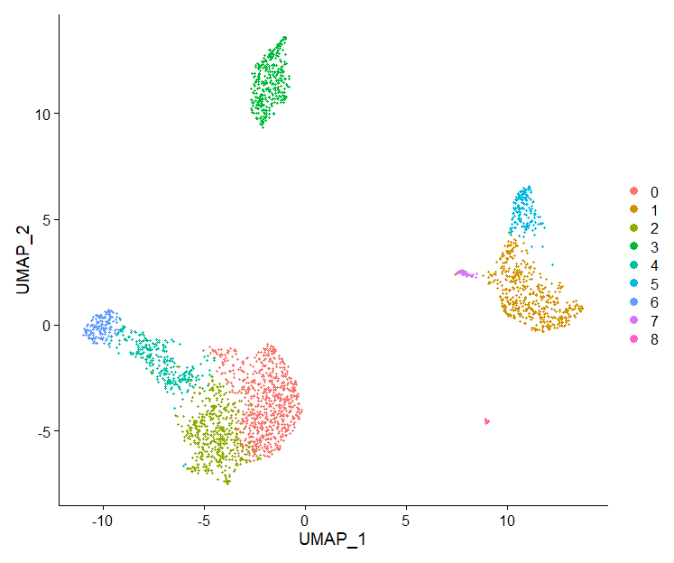
UMAP Visualization of Data

Slide 15
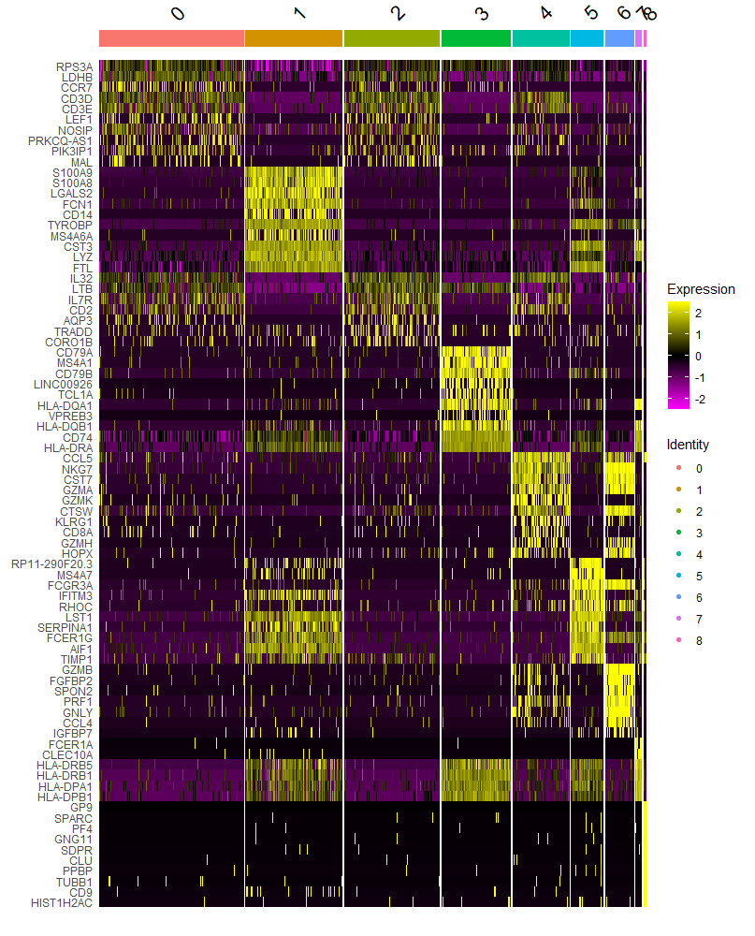
Cluster-Specific Heatmap

Slide 16
Assigning identities to clusters

Slide 17
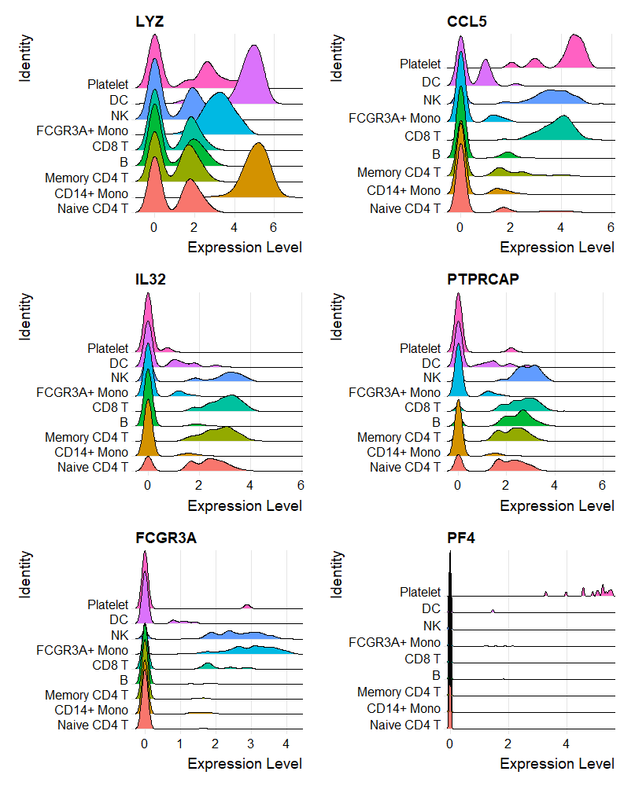
Gene Expression Analysis Using Ridge Plot

Slide 18
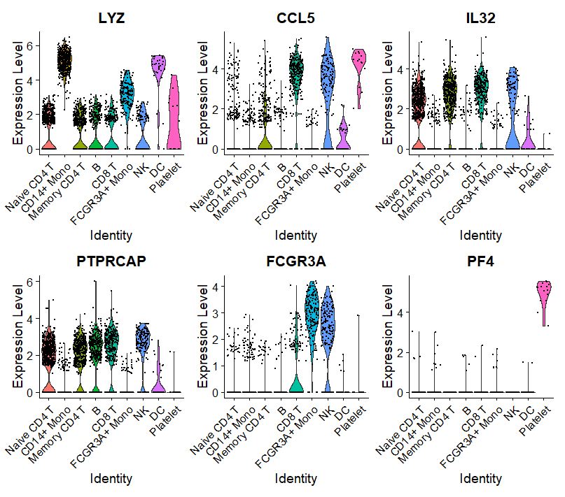
Violin plot after cluster identification

Slide 19
Conclusion

Slide 20
Thank you
Salwa Elsaadawy
sme76@georgetown.edu

